Slide 1

Reducing Errors in the Diagnostic Process:
Strategies to Address Common Pitfalls
Heuristics, Biases, Improvement Science and Improving Diagnostic Decision-Making
Karen Boudreau, MD
Community Learning Session
May 4th, 2016

Slide 2
Outline
Reflexive Exercise
Heuristics, Cognitive Biases and How Did We Get Here?
How does Change happen in your practice?
Model for Improvement, Using Data
Testing Changes to Reduce Risk of Diagnostic Errors – individual and team

Slide 3
Reflexive Exercise
5 Min – First part is just for yourself/backdrop for the discussion
Jot down a paragraph or two (or bullets) describing a time when you were involved with or witnessed a diagnostic error or near miss
  What happened?
  How did you feel?
  Did anybody talk about it?
  Did anything change as a result?

Slide 4
Think Back to Your Training
Diagnostic Process:
  History taking
  Physical Exam
  Review of objective data
  Formulation – divergent then convergent thinking around a differential diagnosis, working diagnosis and proposed treatment plan
  Usually done alone – in isolation
Some highlights of techniques I remember being taught:
  Value of a tincture of time – both forward (let’s see how this plays out a bit) and reverse (bad things get worse, you’ve been pretty stable)
  “Worst-case scenario” differentials – in my day, everyone was suspected of having Lupus or Wegener’s Granulomatosis
  Ducks, Horses and Zebras
  Never underestimate the power of a careful history

Slide 5
Now Think Back to Your Last Patient Session
When did you think you knew what was going on?
  When all available information points to a horse not a zebra?
  Within 10 seconds of your patient beginning their story?
  When you recalled the news report about widespread influenza in the region?
  When you saw the chief complaint recorded by your assistant?
  When you saw the patient’s name on your schedule?

Slide 6
Your Best Strength Can Add Risk
Our Best Training
  +
  Years of Experience
  +
  Routine of Practice
  +
  Patient Volume, Efficiency and Productivity Pressures
  We get really good at arriving at a diagnostic conclusion quickly, and with as little information as is necessary
  Is this a good thing or a bad thing?
  It depends!

Slide 7
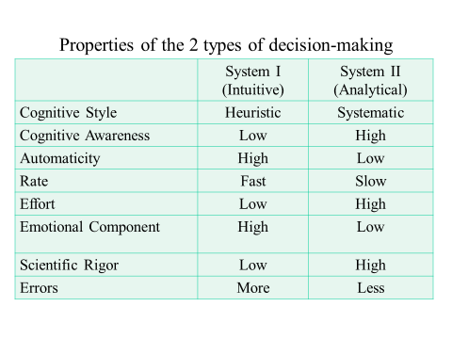
Two Decision-Making Systems
From Penn Teaching Collection, Joan M. Von Feldt, MD, MSEd
Professor of Medicine, Dual Process and Cognitive Bias in Clinical Decision-Making
http://www.improvediagnosis.org/?ClinicalEducation
Notes:
Which do people think they use most of the time when seeing patients?

Slide 8
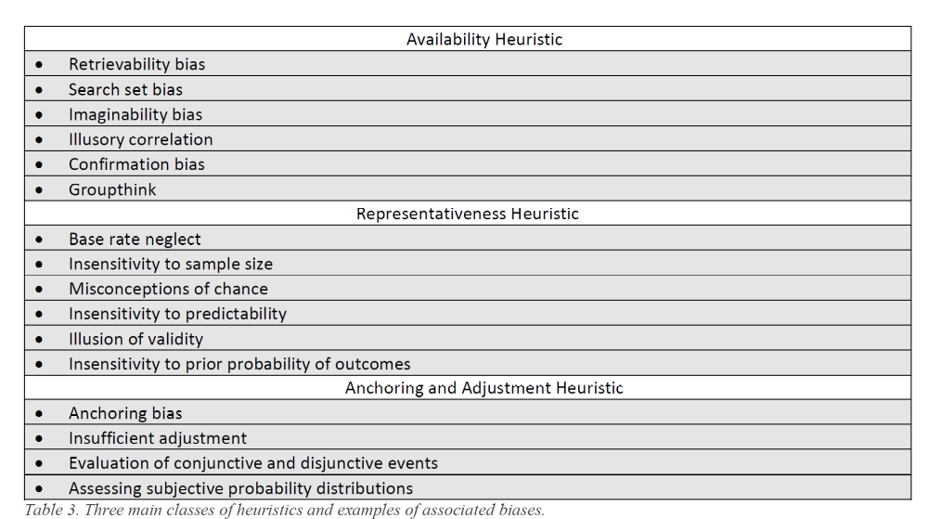
Three Main Heuristic Classes and Associated Biases
(http://usacac.army.mil/sites/default/files/publications/HDCDTF_WhitePaper_Cognitive%20Biases%20and%20Decision%20Making_Final_2015_01_09_0.pdf )
Notes:
the notion that the more examples one can recall of a particular outcome to a situation or event (i.e. how “available” those memories are), the more likely one will judge that outcome happening again in a similar situation or event in the future
The representativeness heuristic is evident when the mind places a situation, event or phenomenon into a class or type according to how well, at first glance or consideration, it resembles that class or type. Problem is people tend to overestimate representativeness and underestimate other factors like prior probability
people tend to be moored to their first estimate of a phenomenon and typically do not take other considerations into proper account when modifying their judgment over time. “diagnosis my scheduled chief complaint”

Slide 9
Three Common “Brain Traps”
Cognitive Biases or Cognitive Dispositions to Respond
Anchoring: the tendency to perceptually lock onto salient features in the patient’s initial presentation too early in the diagnostic process, and failing to adjust this initial impression in the light of later information. This CDR may be severely compounded by the confirmation bias.
Confirmation bias: the tendency to look for confirming evidence to support a diagnosis rather than look for disconfirming evidence to refute it, despite the latter often being more persuasive and definitive.
Premature closure: a powerful CDR accounting for a high proportion of missed diagnoses. It is the tendency to apply premature closure to the decision-making process, accepting a diagnosis before it has been fully verified. The consequences of the bias are reflected in the maxim: ‘‘When the diagnosis is made, the thinking stops.’’

Slide 10
Naturalistic Decisions
“The [Naturalistic Decision-Making] NDM school of thought, largely developed through the empirical work of psychologist Gary Klein, denies the need to mitigate biases at all and instead proposes to appropriate them in order to improve decision making.”
“biases may be able to be leveraged, through expertise, to make good decisions. Much of the empirical evidence used to support his model comes from real world examples in professions where quick, intuitive decisions are necessary and common— such as small unit leaders in the Marine Corps, nurses and firefighters.”
(http://usacac.army.mil/sites/default/files/publications/HDCDTF_WhitePaper_Cognitive%20Biases%20and%20Decision%20Making_Final_2015_01_09_0.pdf )

Slide 11
How Common are these Errors?
The IOM report cites a 2014 observational study[5] estimating that 5% of US adults, or 12 million patients a year, are misdiagnosed. Many of these errors are thought to be relatively harmless, but some of them lead to serious complications and death.
A 2011 survey[8] on diagnostic errors by QuantiaMD, collaborating with Dr Wachter, polled more than 6400 clinicians—almost three quarters of whom were physicians. Only about one half said that they came across a misdiagnoses at least once a month in their healthcare setting – a much lower rate than 5% of all diagnoses, and more in line with estimates of serious misdiagnoses.
In a 2013 study,[9] the most common misses were pneumonia (6.7%), decompensated congestive heart failure (5.7%), acute renal failure (5.3%), cancer (5.3%), and urinary tract infection (4.8%).
Many misdiagnoses of common diseases involve an atypical presentation.
http://www.medscape.com/viewarticle/860747
Notes:
Really difficult to know because both measurement and reporting are limited, and many providers are skeptical of preventability.

Slide 12
Small Group Exercise
Use either the Texas Presbyterian example (next slide) or one of the examples in your group
Take 5 minutes to list the possible cognitive biases that might have contributed to the issue
Identify whether factors are primarily impacted by individual decision-making, system issues or both
Record your group’s findings – report out to larger group

Slide 13

THD Emergency Department, Mr. Duncan’s Initial Visit
On September 25, 2014, Mr. Duncan, arrived at the Emergency Department of Texas Health Presbyterian Hospital Dallas with complaints of dizziness, abdominal pain, nausea, and headache, and later the Emergency Department physician added symptoms of rhinorrhea and nasal congestion following the physical exam. After a wait of approximately an hour, the patient was taken back to the treatment area and assessed separately, first by a nurse and then by a physician. During the nursing assessment, when questioned as part of the influenza screening process, the patient identified that he had recently travelled from Africa. This information was documented in the patient record; however, it was not communicated verbally to the physician as directed by a prompt in the EHR. According to the record, the physician or scribe noted in a separate area of the EHR that the patient stated that he was from the Dallas area. 5
During Mr. Duncan’s first visit to the Emergency Department, several diagnostic tests were performed including blood work and head and abdominal computed tomography scans. Blood analysis showed low white blood cell and platelet counts and mildly elevated liver enzymes. CT scans of the head and abdomen were unremarkable.
The patient received intravenous fluids and Tylenol. Over the course of the Emergency Department stay, the patient’s temperature increased from 100.1 to 103.0, although it dropped to 101.2 after Tylenol and at the time of his discharge from the Emergency Department approximately 4 hours later. In addition, his heart rate increased from 90 to 104 (at discharge), and his blood pressure was stable at discharge. The automatically calculated Systemic Inflammatory Response Syndrome (sepsis) Score was displayed on Emergency Department monitors and rose from 0 on admission to 3 (out of 4) at discharge. The patient was discharged with a diagnosis of sinusitis and given prescriptions and instructions to return to the Emergency Department or go to his primary care provider if his symptoms worsened.
https://psnet.ahrq.gov/resources/resource/29368/the-expert-panel-report-to-texas-health-resources-leadership-on-the-2014-ebola-events

Slide 14
Easier to Admire than to Remedy
“Despite the vast body of research that has followed the initial work on heuristics and biases in the 1970s, there remains a distinct lack of published research, let alone consensus, on appropriate and effective methods of cognitive “debiasing”.121,122 Reinforcing a number of the criticisms noted above, it seems that the field has achieved much more progress towards cataloguing and describing an ever-growing list of cognitive biases than it has towards developing and identifying practices to prevent or remedy them.”
(http://usacac.army.mil/sites/default/files/publications/HDCDTF_WhitePaper_Cognitive%20Biases%20and%20Decision%20Making_Final_2015_01_09_0.pdf )

Slide 15
Debiasing
“Debiasing involves having the appropriate knowledge of solutions and strategic rules to substitute for a heuristic response as well as the thinking dispositions that are able to supersede intuitive thinking.”
  Be aware of strategies to overcome biases
  Be able to detect need to overcome bias
  Be cognitively able to decouple/suppress intuitive thinking with analytic
(http://usacac.army.mil/sites/default/files/publications/HDCDTF_WhitePaper_Cognitive%20Biases%20and%20Decision%20Making_Final_2015_01_09_0.pdf )

Slide 16
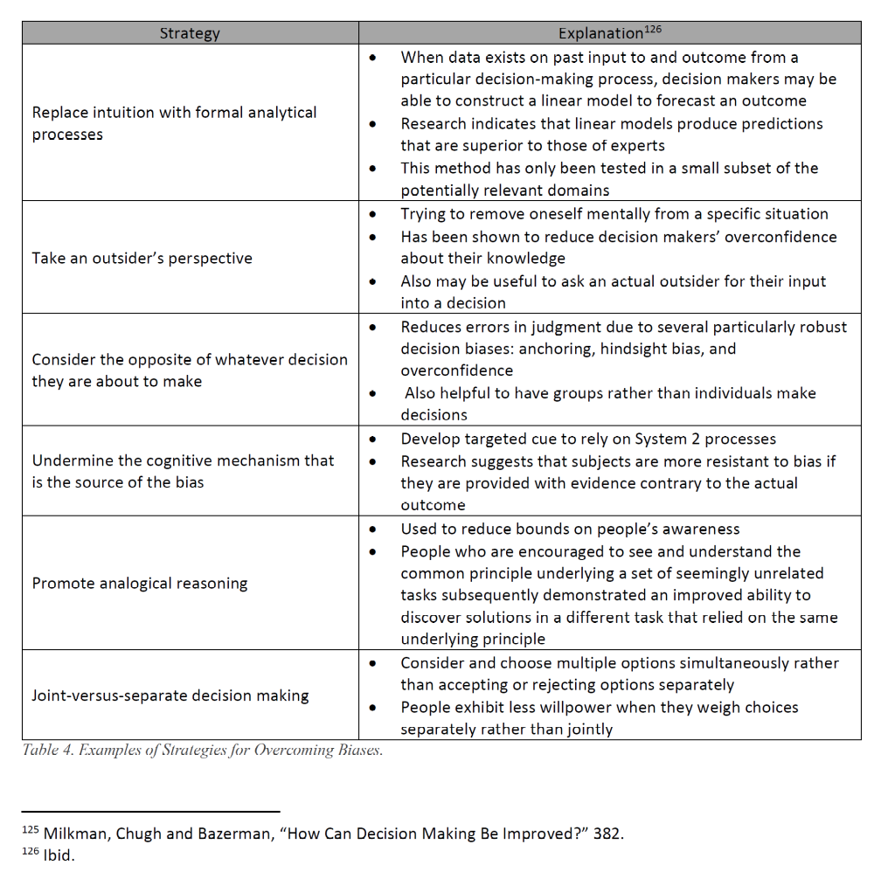
Sample Strategies
(http://usacac.army.mil/sites/default/files/publications/HDCDTF_WhitePaper_Cognitive%20Biases%20and%20Decision%20Making_Final_2015_01_09_0.pdf )

Slide 17
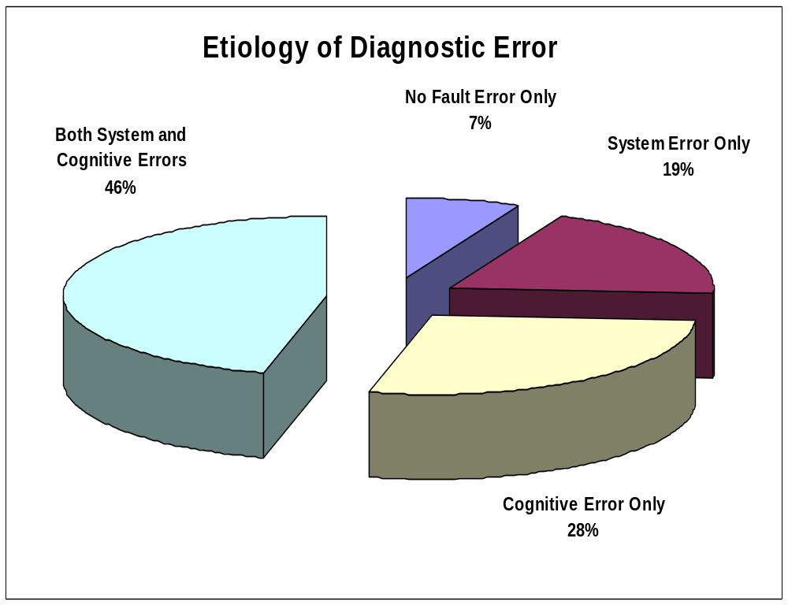
http://www.improvediagnosis.org/?Remedies

Slide 18
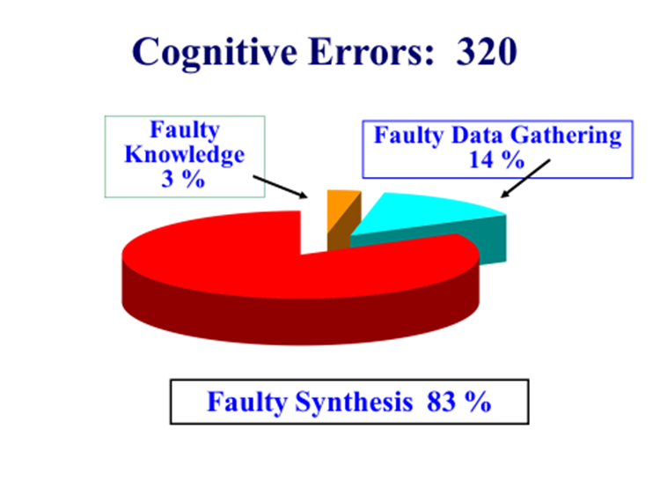
http://www.improvediagnosis.org/?Remedies

Slide 19
COGNITIVE ERRORS (n = 320)
Most common:
Premature closure (39)
Faulty context generation (26)
Faulty perception (25)
Failed heuristic (23)
http://www.improvediagnosis.org/?Remedies

Slide 20
Potential Strategies
“Hypothesis testing” of a working diagnosis with your patients
Checklists to stall premature closure
        what else could it be?
Look for other possible explanations and disconfirming information with patients to mitigate anchoring and confirmation bias
    what data doesn’t fit?
Notes:
Vigilence and awareness are insufficient to overcome CDRs – need reliable processes to mitigate
Possible approaches:
“Hypothesis testing” through empiric treatment with feedback – engaging the patient with specific information about the working diagnosis and proposed treatment including:
why you feel a particular diagnosis is the most likely
Learning from the response to the treatment will help to make clear whether or not the diagnosis is correct
Here’s what you should expect in this specific period of time – please call the office then and let us know (either way) how you are feeling:
Better/things went as expected – our working diagnosis is more likely to be correct
The same/worse/things didn’t go as expected – our working diagnosis needs to be modified/reconsidered
“Start again from the beginning” - go back and take the history again.
Overcoming premature closure
Make sure to think more, make a more complete differential diagnosis list – “what else could this be?”
Consider what can’t we explain?
What else could be contributing – for instance, could medications (known or unknown) be the underlying cause or a contributing factor
Consider use of a checklist (such as Graber’s) to prompt broader thinking/delay closure
Overcoming anchoring and confirmation biases
Look for ways to slow down the diagnosis-defining process such as re-asking some of the key triage/chief complaint questions
Specifically look for data or information that doesn’t fit the “typical” picture (disconfirming information)
Is it possible that there is more than one problem? (We are always looking for the unifying diagnosis)
Ask the patient if there is anything that they have been thinking or worrying about/experiencing that might not seem related/or that you didn’t ask about
Find a colleague to “talk you out of” your diagnosis
Identify for yourself what symptom or factor is anchoring you to the diagnosis – specifically try to identify another potential anchor. (e.g. This patient has severe COPD with frequent exacerbations. His breathing and oxygenation are worse, it is most likely a COPD exacerbation. Anchoring to his common recurring pattern. But he just flew home from Australia. Could that be the most important factor?)

Slide 21
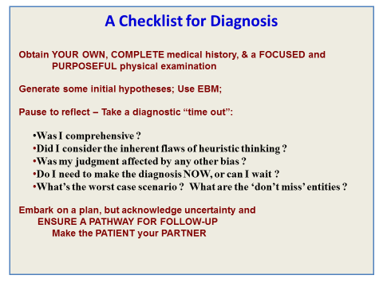
Graber Checklist Example (ED)
http://www.improvediagnosis.org/?Remedies

Slide 22
Systems Helps and Hurts?
What processes or systems do you have or can you imagine that might:
  Contribute to cognitive bias?
  Help you avoid getting caught in cognitive biases?

Slide 23
Do Try This at Home!
Proposed small tests of change at the March 4 session
Any observations to share?
Notes:
These tests aren’t “the answers” but they are intended to provide an initial experience into deliberate actions to mitigate some of these brain traps. The ultimate goal is to develop consistent and reliable processes that work in your setting to routinely challenge our natural tendencies.

Slide 24
Mt. Auburn Examples
Hypothesis Testing:
  “When I am uncertain of the diagnosis, I generally ask the patient to call back in a certain time frame (depending upon the presumptive Dx and level of illness) - and either let my assistant know if they're better or to talk to me if not.”
  What happens if the patient doesn’t call? Can we be confident that they’re better/dx was correct? What else could be tried?
Anchoring and the EMR: - especially the scheduling side
  “patient calls complaining of say sinusitis and the appointment is booked for sinusitis - this patient will get diagnosed with sinusitis no matter what happens at the visit!”
  What could be tried to avoid this anchoring to the initial complaint?

Slide 25
How Does Change Happen in Your Practice?
Notes:
Brief call-outs from the audience
Possible prompts:
physician in charge decides and gives directive?
lead nurse or office manager decides and implements?
Does anyone test or pilot before implementing something?
etc

Slide 26
Brief Intro to QI and Model for Improvement
http://ocw.mit.edu/courses/health-sciences-and-technology/hst-s14-health-information-systems-to-improve-quality-of-care-in-resource-poor-settings-spring-2012/lectures-and-videos/MITHST_S14S12_lec07_1105.pdf
Notes:
21-24 may be too much detail/esoteric. Thoughts?

Slide 27
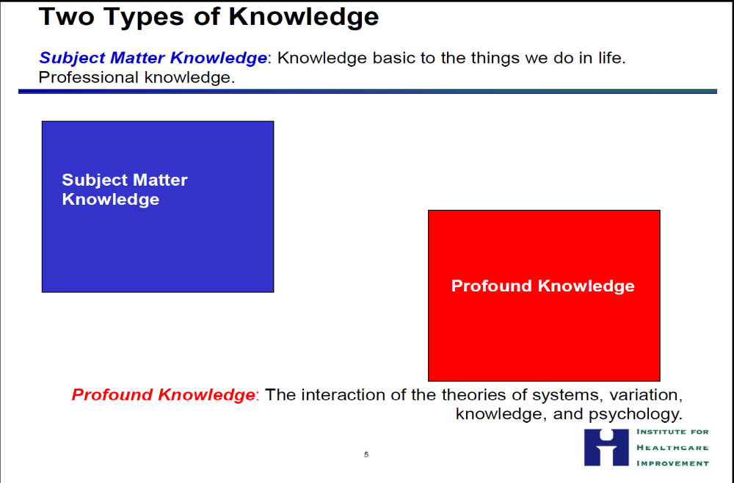

Slide 28
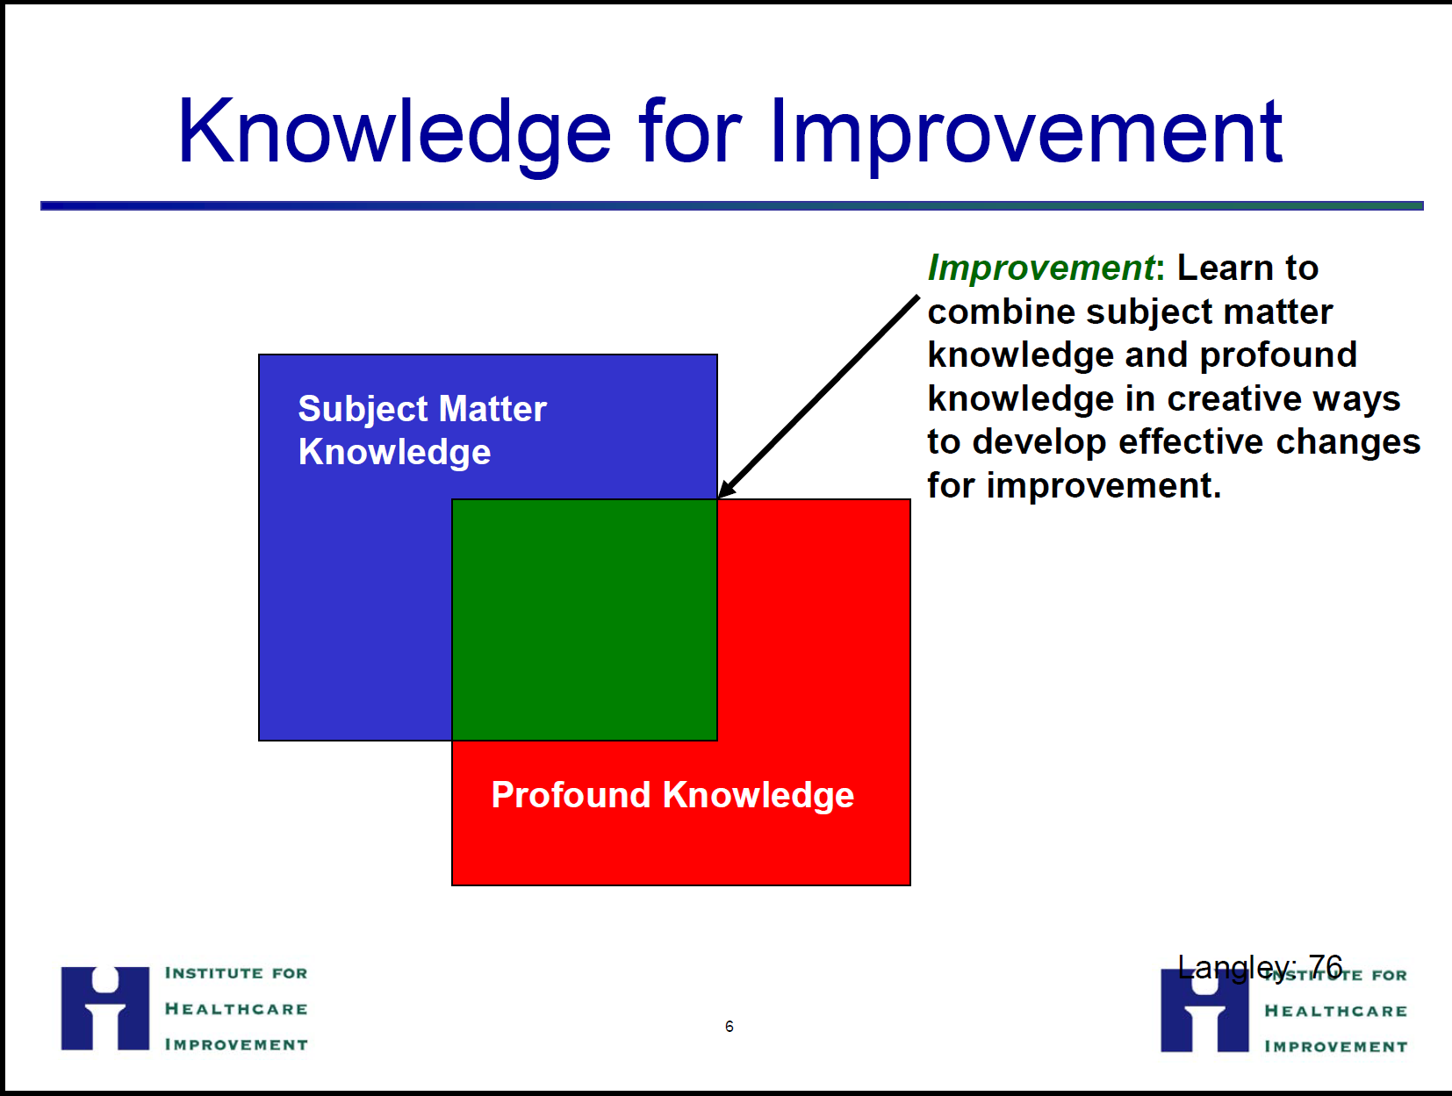

Slide 29
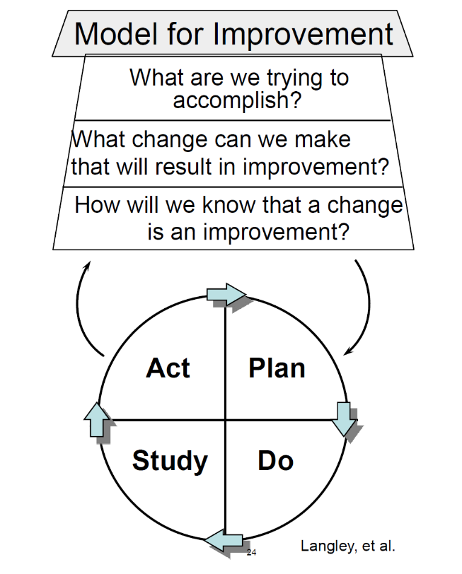
The Model for Improvement
One way to approach quality improvement
Based on the scientific method
Gives order and structure to improvement work
Can be applied at the project and the change level
Langley G., Nolan K., Nolan T., Norman C., Provost L. (1996, 2009) The Improvement Guide: A practical approach to enhancing organizational performance. Jossey-Bass
Notes:
1. Specifically what are you trying to do – either in a test or in a project
2. Sources of Change Ideas
•people providing the service
•Clients
•best practice
•Guidelines
•change ideas/concepts
•novel ideas developed through creativity methods
•identifying underlying challenges (root cause analysis)
3. Is change improvement – DATA AND MEASUREMENT -
measurement may differ from process/outcome measures, meaning an individual PDSA may capture data about performance at one step in a process that you normally do not collect

Slide 30
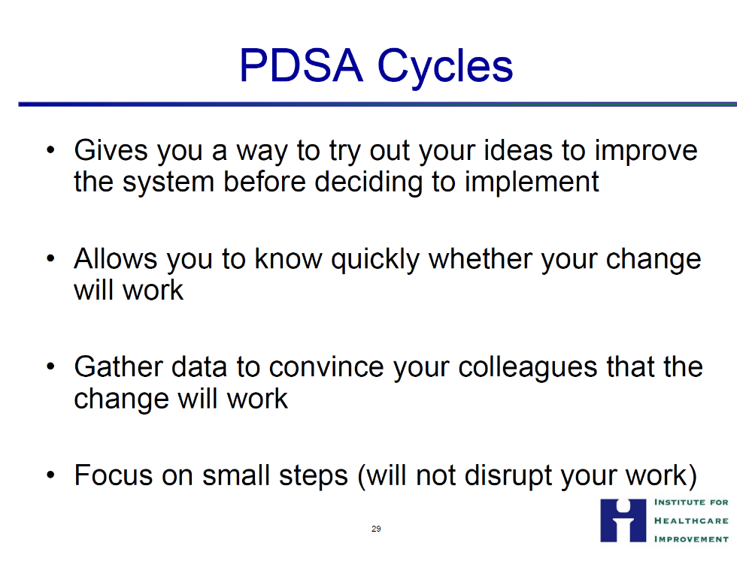

Slide 31
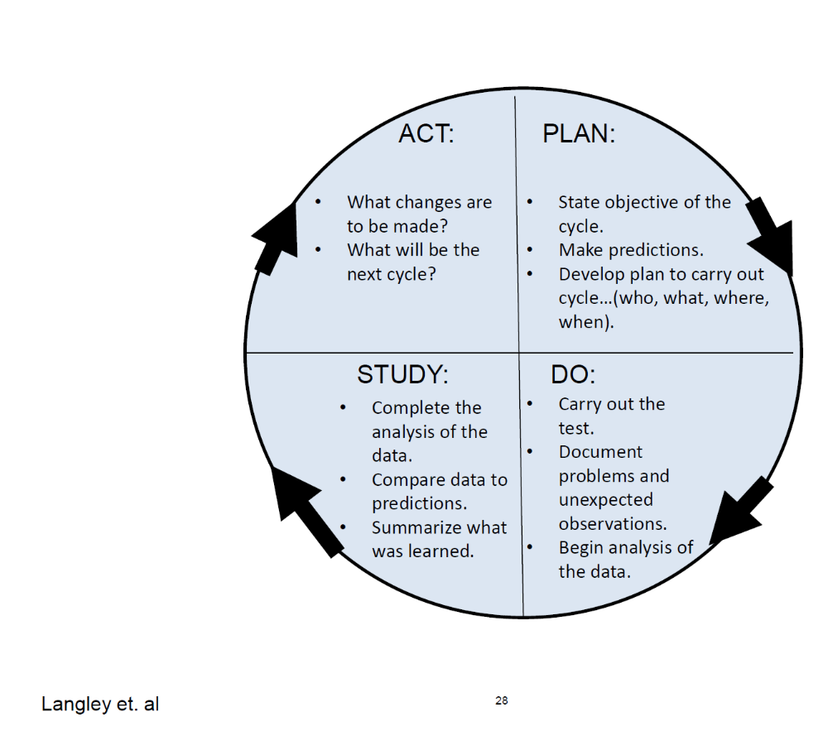
PDSA
  • Every plan has a prediction – what you think will happen
  • Be as specific and as small as possible
  • Should be measurable with data collection being very important
  • Should be analyzed for success and acted upon through a new plan or a scaled up cycle

Slide 32
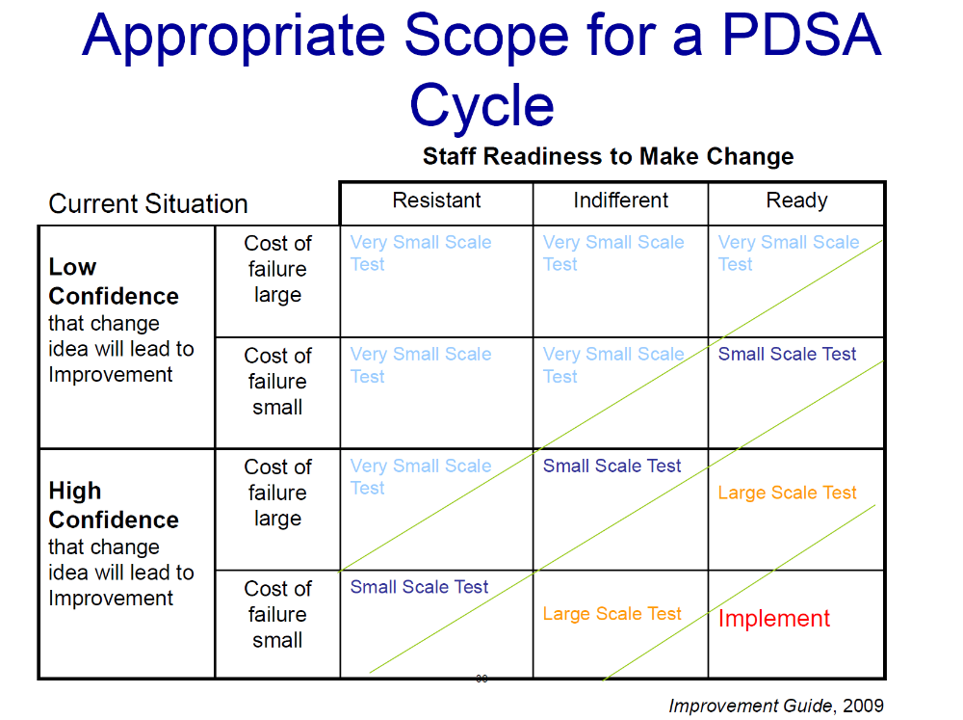
Notes:
This might be too much – could come out or go into an appendix

Slide 33
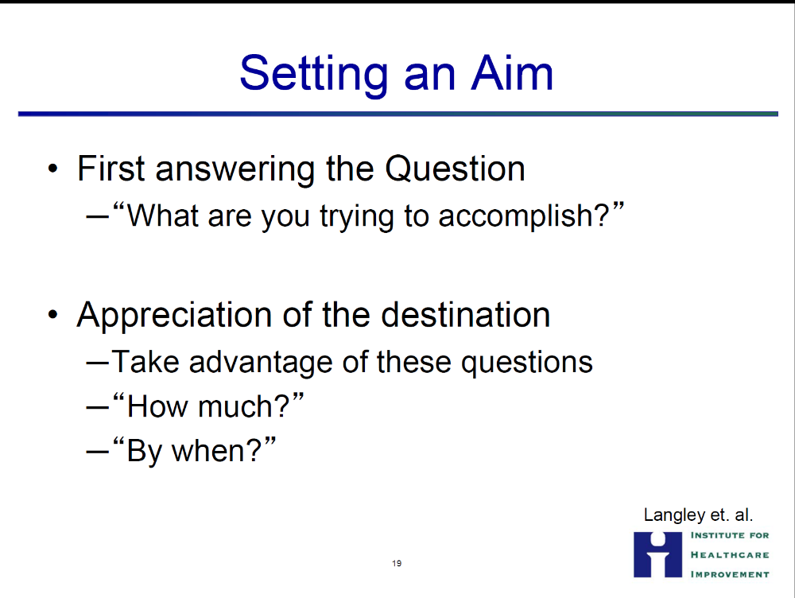
Notes:
And can you measure it? Whether for a project or a test.

Slide 34
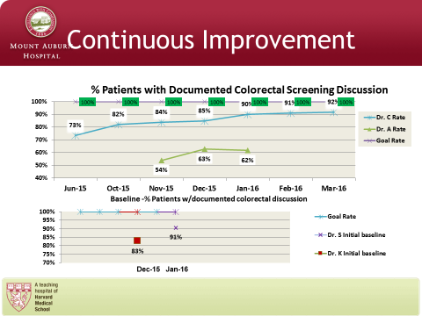
Notes:
If this isn’t a good one to use, we can put a different one in.
Example of a run chart of a process. Tracks progress of the project over time – would love to see additional annotations to show changes tested or changes implemented/

Slide 35
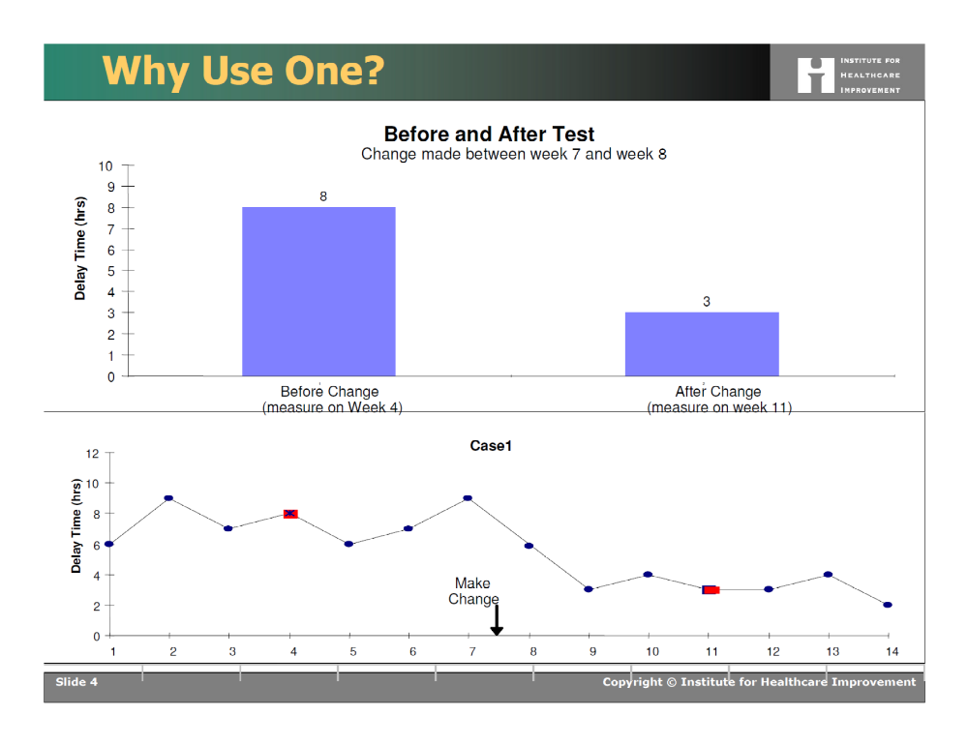
Run Chart – Measurement over time
Run Charts from Healthcare Data Guide by Lloyd Provost
and Sandy Murray

Slide 36
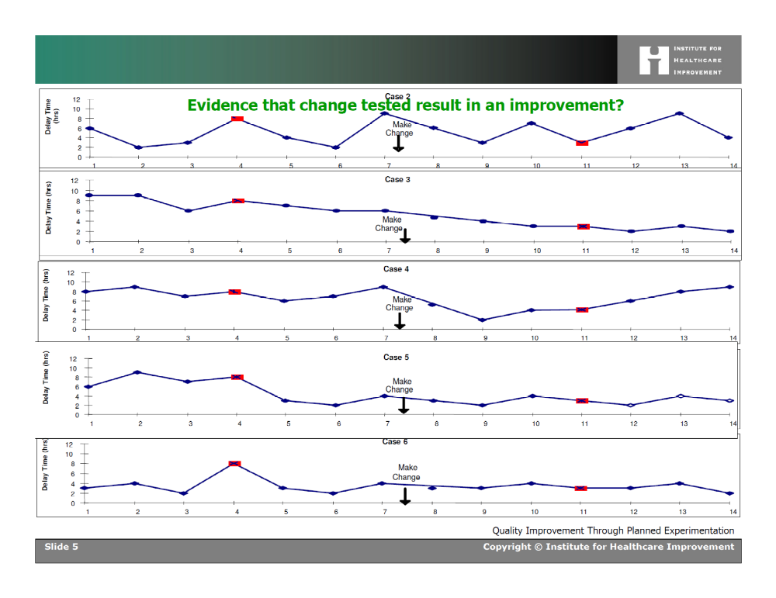
Same B&A
Run Charts from Healthcare Data Guide by Lloyd Provost
and Sandy Murray
Notes:
The purpose of measuring interventions is to establish whether change is resulting in improvement so you can decide whether to make the change permanent/spread it etc.

Slide 37
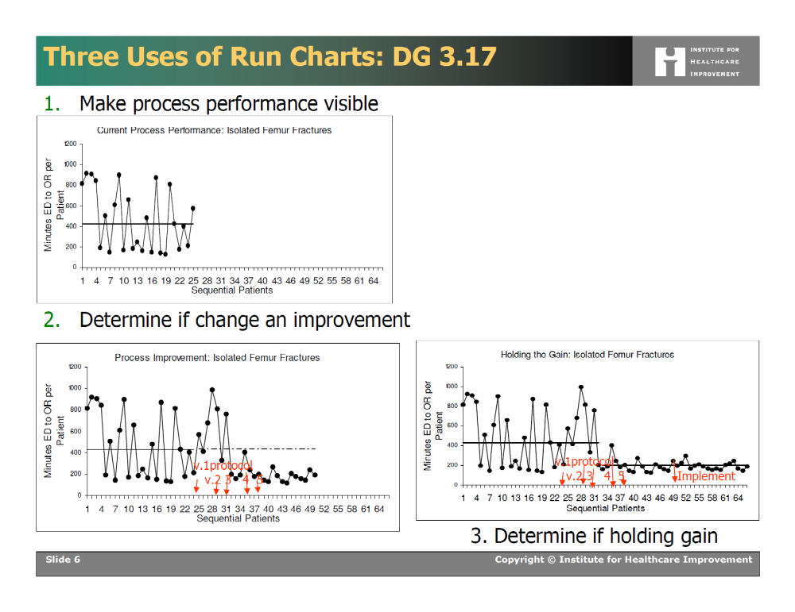
Examples of Annotated Run Charts
Run Charts from Healthcare Data Guide by Lloyd Provost
and Sandy Murray

Slide 38
Final Exercise
Choose one factor from your group’s earlier examples
List a small number of ideas you could test
What would you be seeking to accomplish with testing one of these ideas?
How would you measure whether the test results in improvement?

Slide 39
Summary
The art and science of diagnosis rely on both system 1 (automatic) and 2 (analytic) thinking
Heuristics help us but make us vulnerable to cognitive traps
“Debiasing” may help avoid traps – requires situational awareness and ability to override automatic thinking
Started developing ideas to mitigate bias in your own context

Slide 40
More Summary
The Model for Improvement can offer a practical method for testing improvement strategies
  Three questions
  Prediction
  Measurement over time (with annotations!)
  Cycles of testing before implementing
Improvement is a process; improving a system requires participation of the system

Slide 41
Questions, Comments, Discussion

Slide 42
Driver Diagram
Another tool to help focus test ideas
Secondary Drivers
Primary Driver
Secondary Drivers
Aim Statement
Secondary Drivers
Primary Driver
Secondary Drivers
Primary Driver
Secondary Drivers

Slide 43
Diabetic Eye Exam Driver Diagram
Correct diagnosis codes in EMR
Correct identification of Diabetic Patients
Ran correct pt reports
Increase Diabetic Eye exams from baseline of 30% to 75% by 12/31/2016
Pt has correct info to make apptmt
Patients complete Diabetic Eye Exams
Pt understands importance of eye exam
Practice receives results
Specialist has correct practice contact info

